Slide 1
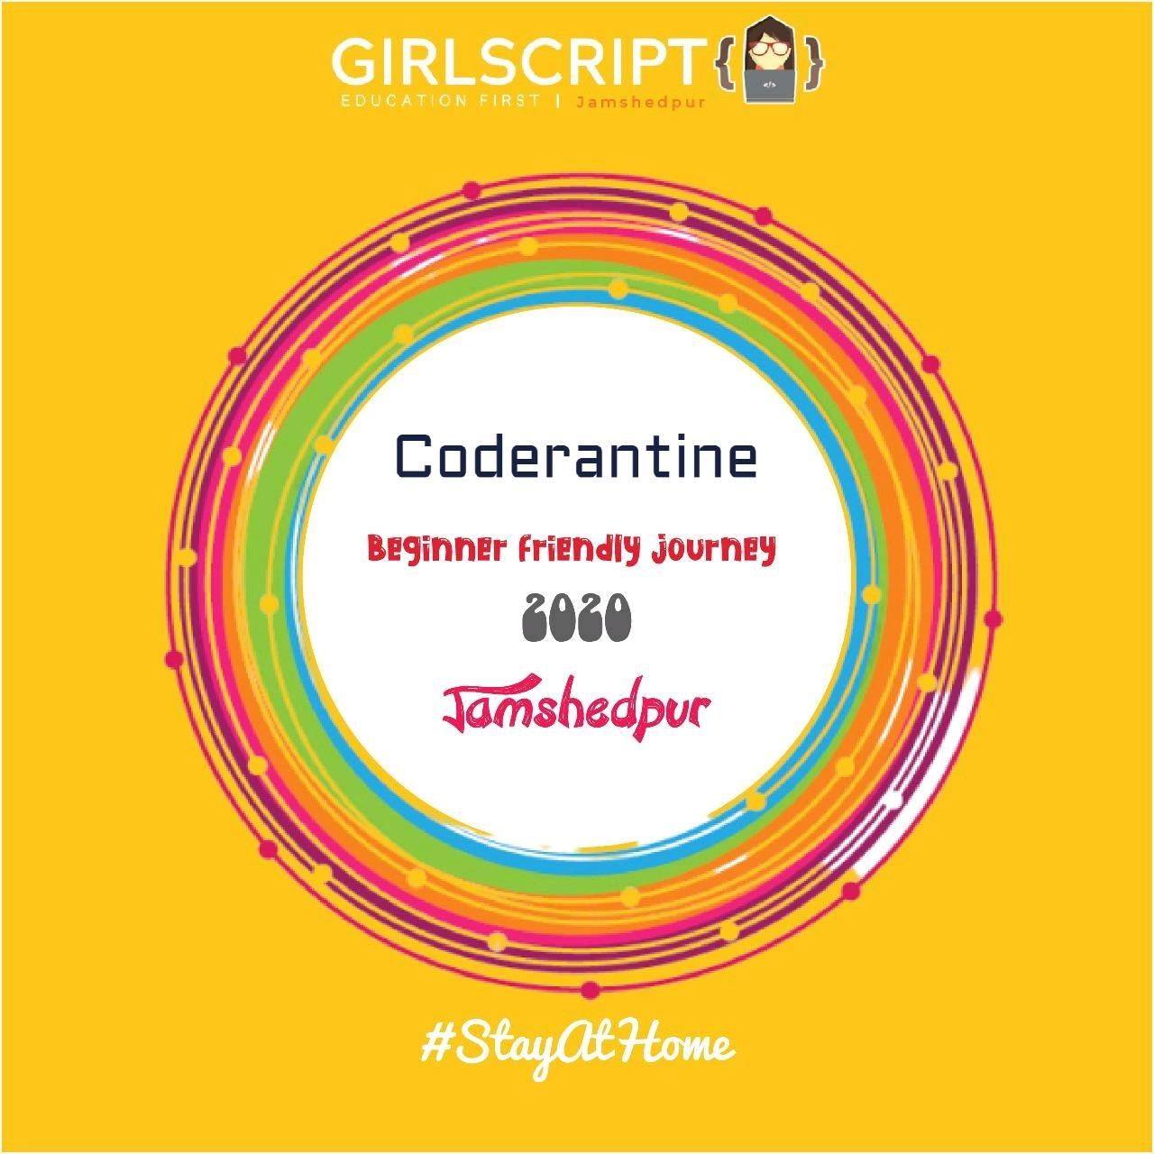
Python Programming
Day 4

Slide 2
Why do we need functions and methods?
>> Many times we need to implement the same set logic (or codes) on different objects.
>> But, writing the same code over and over again can be cumbersome, tiring and consume a lot of time.
>>It is also not feasible on a long term basis.
>> So, we put together these logics(or codes) which are to used repeatedly, in a block and term that as a function.

Slide 3
How do define a function?
Syntax of a (user defined) function:
def name_of_the_function(arg1, arg2..): # body_of_the_function
A point to note: We don’t specify the “type” of the function in python,i.e, we don’t have to mention beforehand the type of value the function will return, like int, float, void etc.

Slide 4
Example 1:
def funchello(): print(“Hello”)
Example 2:
def funchello(name): print(“Hello ”+name)

Slide 5
Use of return keyword
>> In most of the cases, we don’t have to display the result in the function. But, instead we need to assign it to some other variable.
>> The return statement does not print out the value it returns when the function is called. It however causes the function to exit or terminate immediately, even if it is not the last statement of the function.

Slide 6
Example 1:
def hellof(name): print(“Hello”+name)
result=hellof(“Robert”) >> Output: Hello Robert
result >> type(result) >> NoneType

Slide 7
Modification:
def hellof(name): return(“Hello”+name)
result=hellof(“Robert”) >>
result >> Hello Robert type(result) >> str

Slide 8
Example 2: Write a function to calculate factorial of a number. Using this function, find out the factorial of each element in a list. Ans:
def fact(n): if(n==0): return 1 pdt=1 while(n>0): pdt=pdt*n n=n-1 return (pdt)
list1=[1,2,3,4] factlist=[ ]

Slide 9
for item in list1: factlist.append(fact(item))
factlist
>> Output: [1,2,6,24,120]
Example 3: Check if a word is present in a string or not.
Ans: def check(string): return (“life” in string.lower() )

Slide 10
*args and **kwargs
Use of *args
>> It is used to pass a non-keyworded, variable-length argument list.
>> What *args allows you to do is take in more arguments than the number of formal arguments that you previously defined.
>>By convention, * it is often used with the word args. But you can use any name here. Like, *xyz will work just the same.
>>Using the *, the variable that we associate with the * becomes an iterable meaning you can do things like iterate over it, run some higher order functions such as map and filter, etc.

Slide 11
Example1:
def sumf(n1,n2,n3=0,n4=0): return sum ([n1+n2+n3+n4])
sumf(3,8) >> Output: 11
sumf(1,2,3,4) >> Output: 10
sumf(1,2,3,4,5) >> ERROR

Slide 12
Example 2:
def sumf(*args): return sum(args)
sumf(2,3) >> Output: 5
sumf(1,2,3,4,5) >>Output: 15
Example 3: def display(*args): print(args) print(type(args))

Slide 13
display(1,2,3,4,5) >> Output: (1,2,3,4,5) <class , ‘tuple’>
Use of **kwargs
>> The special syntax **kwargs in function definitions in python is used to pass a keyworded, variable-length argument list.
>>We use the name kwargs with the double star. The reason is because the double star allows us to pass through keyword arguments,i.e, keys and values.
>>A keyword argument is where you provide a name to the variable as you pass it into the function.

Slide 14
Example 1:
def display(**kwargs): print(kwargs) print(type(kwargs))
display(Sam=1,Tim=2, Rob=3)
>> Output: {'Sam': 1, 'Tim': 2, 'Rob': 3} <class 'dict'>
Example 2: def display(**kwargs): for i,j in kwargs.items(): print(i,j)

Slide 15
display(Sam=1,Tim=2, Rob=3)
>> Output: Sam 1 Tim 2 Rob 3
Example 3:
def myfunction(*args, **kwargs): print(“The age of {} is {}”.format(args[0], kwargs[args[0]])
myfunction(“Sam”, “Tim”, “Rob”, Sam=20, Tim=21, Rob=22)
>> Output: The age of Sam is 20

Slide 16
Methods
>>A method in python is somewhat similar to a function, except it is associated with object/classes.
>>Methods in python are very similar to functions except for two major differences.
>>The method is implicitly used for an object for which it is called.
>>The method is accessible to data that is contained within the class.

Slide 17
Difference between methods and functions
>> Let's highlight the key differences between methods and functions: −
>> Unlike a function, methods are called on an object. Like in our example above we call our method.
>>Unlike method which can alter the object’s state, python function doesn’t do this and normally operates on it.

